Slide 1
Installing and Configuring PyCharm
Notes:
[Mandatory Slide] This would be the introduction slide of the topic that you are covering in this subsection.
When this slide plays, you could talk about the main aim that we’d be covering in this video.

Slide 2
In this Video, we are going to take a look at…
What is PyCharm and why choosing it?
Installing PyCharm
PyCharm features tour
Notes:
[Mandatory Slide]
Before the start of the video, we’d like to highlight what are important topics or pointers that we’d be covering in this video. This slide would immediately follow the intro/name slide. This would just be say 2-3 points for the viewers to know what they are getting into.

Slide 3
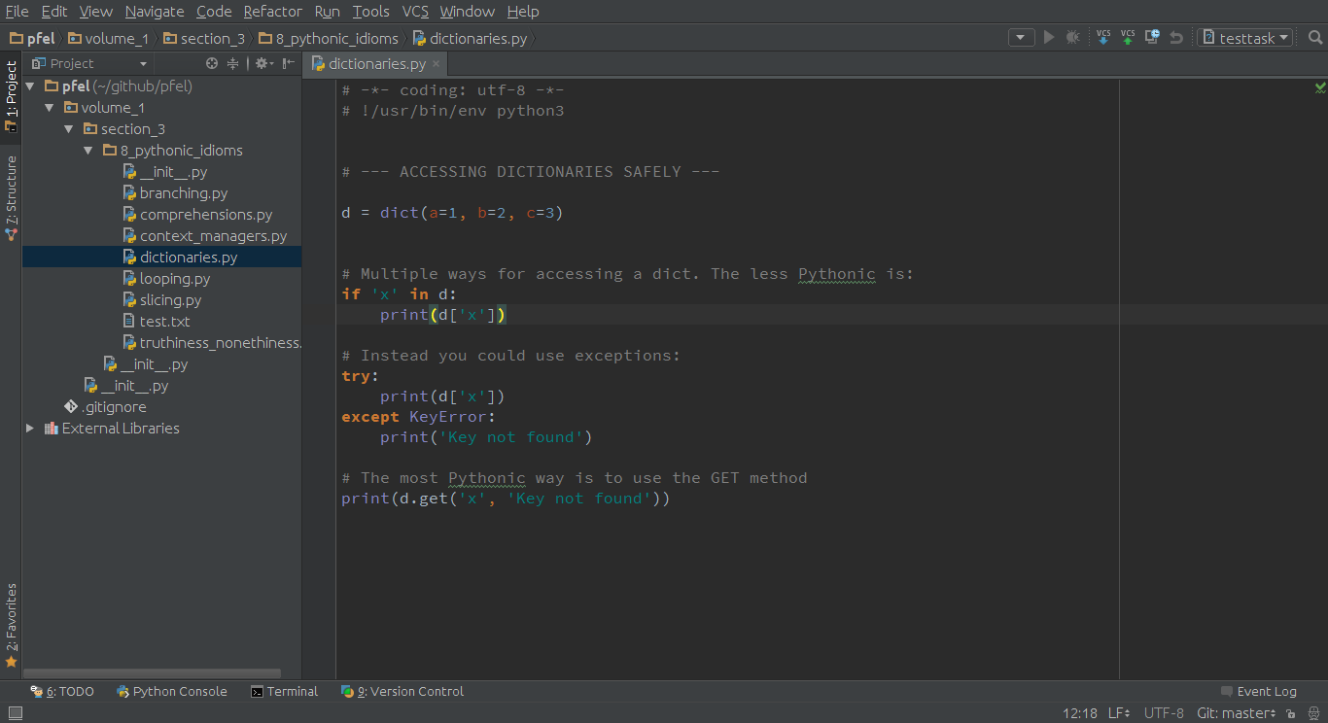

What is PyCharm?
PyCharm is a cross-platform IDE by JetBrains
Two versions available:
Community Edition (free)
Professional Edition (paid)
Notes:
This slide can also be used to cover topics that can be represented by an image/graph etc. Information which is half image/half information type. Like shown in the example above.

Slide 4
Why choosing PyCharm?
Full Python support (syntax highlighting, autocompletion, inspection, ...)
Seamless integration with major VCS (eg. Git)
Support to Python web frameworks & scientific libraries
Rich 3rd party plugin system
Tested and supported by a vast community of developers
Notes:
This slide, like mentioned above is for multiple pointers. The information above covers the types of information that can be used in this slide

Slide 5



Installing PyCharm
Requirements: Python 2.4+, JRE 1.8
Steps:
Visit https://www.jetbrains.com/pycharm/download
Download the installer for your platform. Then:
→ double click on installer and follow the wizard
→ extract the tar.gz archive and launch script bin/pycharm.sh
→ double clik on installer and drag PyCharm icon to your Mac icon
Notes:
This slide, like mentioned above is for multiple pointers. The information above covers the types of information that can be used in this slide

Slide 6
PyCharm features tour
Notes:
Something that needs to grab the viewers attention!!

Slide 7
Summary
What is PyCharm
How to install PyCharm
PyCharm distinctive features
Notes:
This slide, like mentioned is to summarize the various videos we have seen in this section. This gives the viewers a sense of achievement that they have covered exactly what they were looking for.

Slide 8
Keep your work warm
(and safe) using Git
Next Video
Notes:
[Mandatory Slide]
Here the name of the next video needs to be mentioned. The narration as you guessed it would be just letting the viewer know exactly where we are at and what we’d be taking over next! ☺

